Slide 1
Multilevel analysis of individual heterogeneity and discriminatory accuracy (MAIHDA) – using multilevel models to study intersectionality.
Video 2 - Modelling options and the MAIHDA approach.
George Leckie (University of Bristol)
Full resource: https://www.ncrm.ac.uk/resources/online/all/?id=20849

Slide 2
How to model intersectional inequalities
Individuals are defined by a complex combination of identities
And difference/inequalities are produced across those complex combinations of identities
How could we model this?
Option 1: main effects in standard regression model
This will tell us the effects of each separate characteristic, but these are assumed to be the same for everyone. It won’t tell us the combined effect of multiple characteristics
Health = B0 + B1*Male + B2*MinoritisedEthnic + B3*Age …+ e

Slide 3
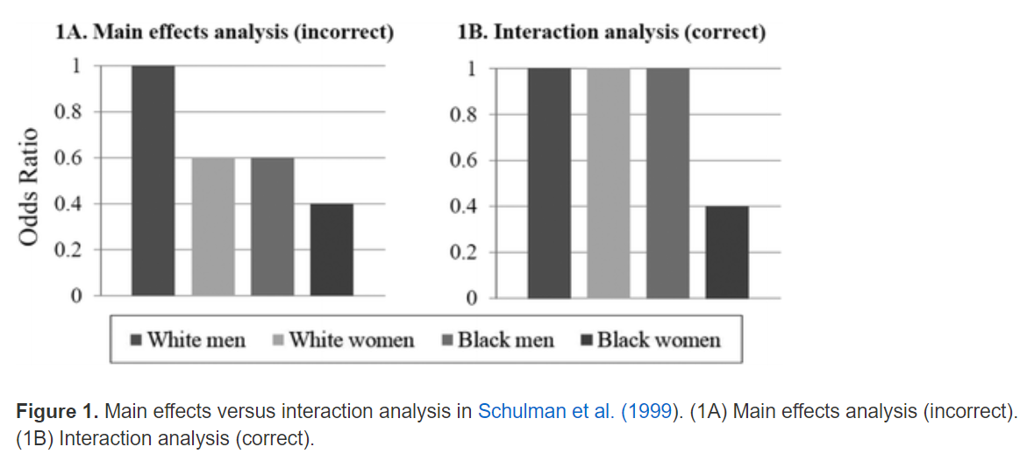
What is intersectionality
Understanding the ways that different dimensions of inequality compound themselves (Kimberley Crenshaw)
Eg Race and Sex

Slide 4
How to model intersectional inequalities
Option 2: add in some interactions
This model is now very complicated! (eg how to interpret what B5 means)
Risk that interpretation focuses on interactions over inequalities
It’s also very much at risk of multiple testing issues
Usually in this approach we would choose (say) 1 theoretically informed interaction, rather than the saturated approach above… ie:
Health = B0 + B1*Male + B2*MinoritisedEthnic + B3*Age + B4*Male*MinoritisedEthnic
Health = B0 + B1*Male + B2*MinoritisedEthnic + B3*Age + B4*Male*MinoritisedEthnic + B5*Male*Age + B6*MinoritisedEthnic*Age + B7*Male*MinoritisedEthnic*Age + e

Slide 5



Back to intersectionality
Option 3: Think of intersectional strata as a level in a multilevel model
Ie: individuals are nested in their intersectional strata
So:
  1: create our intersectional strata – ie a unique id for each combination of our intersectional identities
  2: use these as our level 2 identifiers in a null/empty model
But at present – are these differences produced by just adding intersectional inequalities together, or through interactions/multiplicative differences?
Intersectional strata
$${\left(1\right)Health}_{ij}=β_{0}+(u_{j}+e_{ij})$$
$$u_{j}\sim N(0, σ_{u}^{2})$$
$$e_{ij}\sim N(0, σ_{e}^{2})$$
Individuals

Slide 6
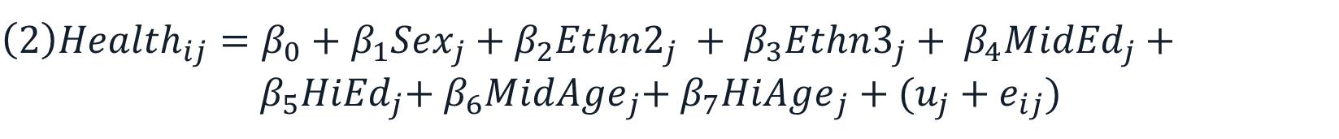



Back to intersectionality
Option 3: Think of intersectional strata as a level in a multilevel model
Ie: individuals are nested in their intersectional strata
We can run two models – one an empty / null model, and one with main effects for our intersectional variables… and see what changes between them
We’d expect the variance of u to reduce – but how much?
Amount of variance remaining = multiplicative.
Intersectional strata
$${\left(1\right)Health}_{ij}=β_{0}+(u_{j}+e_{ij})$$
Individuals
${\left(2\right)Health}_{ij}=β_{0}+β_{1}{Sex}_{j}$ +${ β}_{2}{Ethn2}_{j}$ + ${ β}_{3}{Ethn3}_{j}$ + ${ β}_{4}{MidEd}_{j}$ + ${ β}_{5}{HiEd}_{j}$+${ β}_{6}{MidAge}_{j}$+${ β}_{7}{HiAge}_{j}$ +$(u_{j}+e_{ij})$
$$u_{j}\sim N(0, σ_{u}^{2})$$
$$e_{ij}\sim N(0, σ_{e}^{2})$$

Slide 7
This is MAIHDA
Can answer these sorts of questions:
  How much do our intersectional strata matter? Or How big are inequalities between strata? This is the VPC from model 1
  … Before and after controlling for “main effects” – so are inequalities additive only, or also multiplicative?
    We can calculate the PCV – the proportion of variance accounted for by the main effects
  Which strata are the most advantaged/disadvantaged?
  Which strata deviate most from what would be expected given their (universal) main effects?
  These questions are in many ways well suited to an intersectional lens

Slide 8
This is MAIHDA
In R – just like any other multilevel model (once we’ve created our strata-level variable)
Model1 <- lmer(Health ~ 1 + (1|strata), data=df)
Model2 <- lmer(Health ~ 1 + Sex + Ethnicity + Education + (1|strata), data=df)
And similarly in Stata
mixed HbA1c || stratum:, reml
mixed HbA1c i.sex i.ethnicity i.education || stratum:, reml

Slide 9
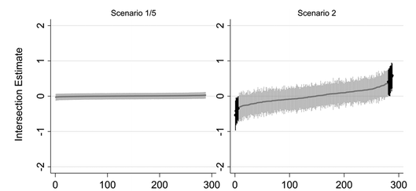
Why not just use loads of dummy variables (FE approach)
We could… but turns out this is equivalent to option 2 above!
No “shrinkage” – estimates may be unreliably estimated (particularly for small intersectional strata)
Greater risk of multiple testing (no shrinkage) – Bell et al 2019
Harder to separate additive and multiplicative

Slide 10
www.ncrm.ac.uk

